Slide 1
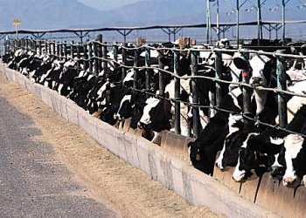
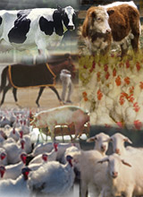
Confined Feeding Operations and You: Bridging the Gap
[Enter your name here]
[Your organization/affiliation]

Slide 2
OUTLINE
What is a CAFO/CFO?
Confined Feeding Dynamics
Perception versus Reality
CAFOs and watersheds
How can we protect watersheds?
Bringing CAFO/CFO operators to the table
Things to Consider
Conclusion

Slide 3
Confined Feeding
Confined feeding is the raising of animals in lots, pens, or buildings, where they are confined, fed and maintained for at least 45 days during the year, and where there is no ground cover or vegetation present over half of the animals’ confinement area.
IDEM
Notes:
A good explanation is taken directly from MacDonald et al. “The key elements in the definition are that the animals are confined; that they are fed, rather than grazed on grass or other vegetation; and that the ‘facility’ refers to a structure, and not to an entire farm” (2009).

Slide 4
Confined Feeding Operation (CFO)
A CFO is defined as any animal operation engaged in the confined feeding of at least:
300 cattle
500 horses
600 swine or sheep,
Or 30,000 fowl (chickens, turkeys, or other fowl)

Slide 5
Concentrated Animal Feeding Operation (CAFO)
Due to potential compliance issues, CFOs that are above a particular threshold are defined as Concentrated Animal Feeding Operations.
CAFO regulations are more stringent than CFO regulations, and require a different permitting process
Notes:
It is important to point out that CAFOs are Confined Feeding Operations, just with more stringent regulatory requirements. This is important when reviewing the State CFO/CAFO rules. CAFOs fall under the same rules of CFOs, but have extra stipulations in the CAFO rule.

Slide 6
Concentrated Animal Feeding Operation (CAFO)
CAFOs are defined as any animal operation engaged in the confined feeding of at least:
700 mature dairy cows
1,000 veal calves
1,000 cattle other than mature dairy cows
2,500 swine above 55 lbs.
10,000 sheep or lambs
55,000 turkeys
30,000 laying hens or broilers with liquid manure handling
125,000 broilers with solid manure handling
82,000 laying hens with solid manure handling
30,000 ducks with solid manure handling
5,000 ducks with liquid manure handling
Notes:
Notice the difference in description of animal thresholds between CFO and CAFO; this is an example of more stringent requirements. The manure handling inclusion is also an example of this difference. *broilers are chickens raised for meat products.

Slide 7
The size of livestock operations have grown increasingly larger over the last 25 years
The production locus increased by 60 % in broilers, 100 % in cattle, 240% in dairy, and 2,000% in hogs between 1987 and 2002 (MacDonald et al. 2009)
Many factors have contributed to the concentration of livestock operations
Changes in production technology
Life stage specialization
Coordination throughout production
Notes:
*Broilers are chickens raised for meat production. It is important to note that the production locus is the farm size, in annual sales, at which one half of national production comes from larger farms and half from smaller farms (similar to a median value). It is important (!) to note that this is NOT the increase in head of livestock, but production.

Slide 8
Enhanced Production Technology
Improvements in breeding led to animals that gain more weight per amount of feed and labor
Automated systems such as milking parlors/feed delivery systems reduce labor costs
Modern barns reduce cost of housing
Automated manure removal and storage systems reduce labor costs
Notes:
Use this opportunity to discuss that overall, these technologies reduce the overall cost of labor and capital input. Also, according to MacDonald et al., the intensive use of these technologies further reduces costs the larger a farm size (2009).

Slide 9
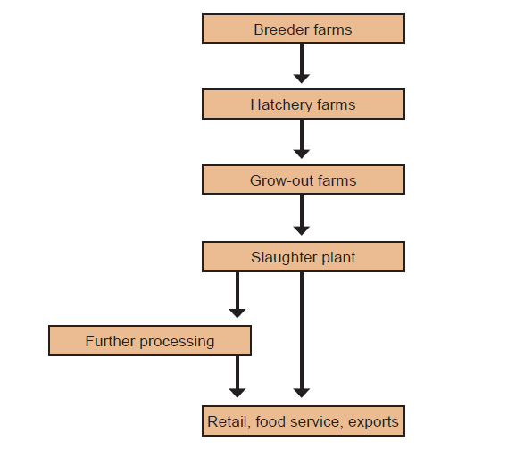
Specialization
Specialization of a particular life stage at a single farm is common place
(MacDonald et al. 2009)
Notes:
This is an example from the paper by MacDonald et al. of broiler production organization.

Slide 10
Coordination throughout Production
This process is called vertical integration
A firm (integrator) owns the hatcheries, processing plants, and feed mills
Farmers are contracted to “grow out” the chicks
Farmers may also provide breeder hens to restart the process
Notes:
A good quote from MacDonald et al. describing the process: “Under a production contract, the integrator provides the farmer/grower with chicks, feed, and veterinary and transportation services, while the farmer provides labor, capital in the form of housing and equipment, and utilities. The birds are sent to slaughter after 5-9 weeks on the farm, and the farmer is paid for the growing services provided” (2009). It is important to note that one of the draws to this system is the reduced financial risk for the farmer in the way of a contract, rather than having to create the entire system on their own at a much higher, personal financial risk. ** Note that this is a description of the typical broiler production, and may differ depending on the livestock. If you want to add more detail of other operations, you could include further slides using the information provided by MacDonald et al. (2009).

Slide 11
The combination of technological advances, specialization of life stages and coordination through production have had a net affect of lowering commodity prices.
Lower commodity prices lead to lower retail food prices, “…such that the benefits from technological improvements and larger farms flow to consumers” (MacDonald et al. 2009)
Notes:
This would be a good time to discuss population growth and the higher demands on resources, including food. Higher demand for food and lower (or steady) prices may also encourage the trend of larger livestock farms.

Slide 12
How does this affect our watershed?

Slide 13
Are there CAFOs in our watershed?
This is a place holder for a watershed map.
Please customize this space with a map of your working watersheds with CAFOs/CFOs marked. This can be done with ArcGIS, or using the Indiana Map (indianamap.org)

Slide 14
Are there CAFOs in our watershed?
This is a place holder for information about the CAFOs/CFOs in your watershed. You can include the types of livestock operations and how may head of livestock they house. If there is some issue specific to CAFOs/CFOs in your watershed you might mention it here.

Slide 15
We have CAFOs
in OUR watershed?!
Should we be concerned?!

Slide 16
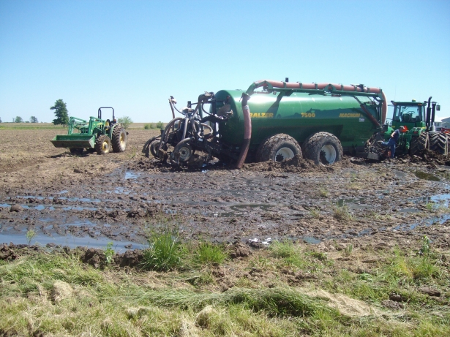
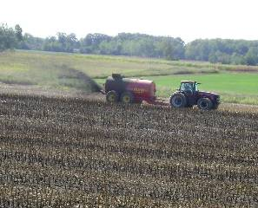
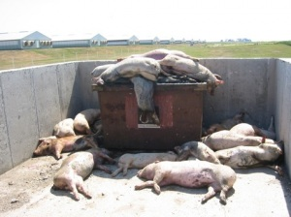
Citizens have a perception of CAFOs…
http://www.disclosurenewsonline.com
http://michigan.sierraclub.org
… is this the reality?
http://www.riverlaw.us/healthissues.html
Notes:
These pictures are meant to stimulate conversation… use this opportunity to discuss how the steering committee perceives confined feeding livestock operations.

Slide 17
The perception isn’t always the reality
Confined feeding livestock operations may be perceived as “factory farms,” but…
Although structured more like industry, larger livestock farms are the result of technology and market changes overtime
Confined feeding livestock operations may cause environmental pollution to surrounding air and waterways, but…
Confined feeding designated as CAFOs/CFOs are regulated by government agencies
Often, worse-case scenario examples of CAFOs are scrutinized and labeled as the norm

Slide 18
What should we do?
“Learn the facts about CAFOs and their regulation!”
Notes:
This is a good opportunity to discuss the importance of having a better understanding of CAFOs from different angles: how they operate, what drives production, what are the environmental impacts, what are the regulations, what are the farming trends, how we can get involved.

Slide 19
Concerns about confined
feeding operations
Notes:
This is a place holder/transition slide to move into the concerns your watershed group might have about CAFO/CFOs.

Slide 20
Manure Management
Higher concentration of livestock creates a large amount of manure in a single area
This could make spills more likely
Larger quantities of manure require more farm acreage for spreading
The amount of nutrients in manure may exceed the agronomic need for crops
Manure may be improperly spread or used on fields
This may lend manure easier access to surface and ground water
Notes:
It is important to note that currently it is not cost-effective to transport manure very far from the livestock operation (MacDonald et al. 2009). This means that nearby crop fields used for application need to be in proportion to the size of the operation, otherwise it could lead to higher application rates than feasible for crop uptake, producing more leaching/runoff of nutrients to water sources.

Slide 21
Antibiotics
Antibiotics are used to treat sick livestock, but subtherapeutic doses may be used preventively to avoid sickness and also to promote growth
There are concerns that constant use of antibiotics will promote development of drug-resistant bacteria
Odor
Proximity of large livestock operations to residences can cause problems with noxious odors from manure storage (gases)

Slide 22
How do we address these concerns?

Slide 23
CAFOs/CFOs are regulated by IDEM
The State regulates several aspects of CAFOs/CFOs, including:
Construction, maintenance, and inspection of confined feeding facilities
Waste management, including:
Manure management
Mortality facilities
Process wastewater (wash water, etc.)
Manure applications and rates
Location and setbacks from other resources
Operation and maintenance records management
Storm water management
Notes:
*Note in your presentation that this is not a comprehensive list; there are other things that the State can regulate. One example that you might point out… in cases of a CAFO/CFO being constructed near an area of sensitivity to ground water pollution, the State may require a CAFO/CFO to complete ground water sampling and compare it to a baseline to determine if they are affecting it. The State also reserves the right to require this sampling if there is evidence that a CAFO/CFO may be affecting the ground water. *You should also explain that the State reserves the right to deny a renewal for continuation of an existing CAFO/CFO if there are issues; they also reserve the right to revoke a permit.

Slide 24
CAFO/CFO Applications require:
A plot map, including location, property boundaries, production areas, boundaries/owners of all manure application areas, and available acreage for manure calculation
A farmstead plan, including surface waters of the State, public/private roads, water well locations, characteristics of karst areas, production surface area drainage patterns, property boundary, all subsurface drainage outfalls, drainage inlets, mortality management sites, and any residence
A waste management system drawing, showing detailed views and cross sections, and elevations.

Slide 25
CAFO/CFO Applications require:
A manure management plan, including:
Procedures for soil testing
Plot maps of application
Soil tests that provide “sufficient information about soil fertility to allow for nutrient recommendations for existing planned crops…” (327 IAC 19-7-5)
Manure test that provides “sufficient information about the manure content to allow for nutrient recommendations for existing/planned crops and to minimize nutrient leaching…” (327 IAC 19-7-5)
A copy of the current manure management plan must be maintained in the CAFO/CFO’s operating record

Slide 26
CAFO/CFO Applications require:
Soil and water table information from test holes for proposed manure storage facilities
A list of potentially affected parties
A “statement affirming that animal feeding operations adjacent to or contiguous with the CFO are not under common ownership or control of the applicant…” (327 IAC 19-7-5)

Slide 27
CAFO/CFO Specifics
This slide is intentionally left blank. Use this slide to discuss specifics of the CAFO/CFO regulations that are of particular concern to your watershed group. This may be construction, manure/waste management, or manure application. This is an opportunity to tailor the presentation to your audience.
Specifics are easily found by following the different rules in the Indiana Administrative Code, Title 327, Article 15 (beginning with Rule 16) and Article 19

Slide 28
What can our group do?
Notes:
If you have a watershed group logo, you might include it on this slide!

Slide 29
Reach out to CAFO/CFO operators in our area
Invite them to a watershed meeting!
Provide them with a fact sheet/handout about our group!
Talk to CAFO/CFO operators about best management of their facilities
New research and technology may be available:
Nutrients in livestock manure can be reduced by changing feed formulations
Manure treatment may be available in the future to reduce transportation costs and make it available for other processes
Subtherapeutic antibiotic use may only be useful for certain stages of production, reducing farm costs and the amount of antibiotics used
Notes:
The most important thing to point out here is that opening a dialog with the CAFO/CFO operators is the first step!

Slide 30
Education and Outreach
Host a CAFO/CFO workshop
Host a Manure Management workshop
Cost-Share Programs
Provide financial assistance to farmers that spread manure
Assistance with Comprehensive Nutrient Management Plans
Equipment modification for manure injection
Let’s be CREATIVE!
Notes:
A CAFO/CFO workshop would be an ideal place to discuss the regulations behind CAFO/CFO operation, and the process they must go through for permits. If you already have a CAFO/CFO operator that you’ve made contact with, a field trip to tour the facility could be incorporated in this workshop. A manure management workshop might be designed more for those farmers that land apply manure from the CAFO/CFO. Don’t be afraid to add other ideas to the list as you see fit.

Slide 31
QUESTIONS?

Slide 32
Contacts
This slide is an opportunity to provide your contact information and other important contacts. You might include regional contacts at IDEM, NRCS, or an SWCD, as you see fit.

Slide 33
Resources and Further Reading
Indiana Dept. of Environmental Management (IDEM): Confined Feeding Operations. (2012). Retrieved April 24, 2012, from http://www.in.gov/idem/4994.htm
MacDonald, J.M. & McBride, W.D. The Transformation of the U.S. Livestock Agriculture: Scale, Efficiency, and Risks. Economic Information Bulletin No. 43. Economic Research Service, U.S. Dept. of Agriculture. January 2009.
United States Environmental Protection Agency (U.S. EPA). (2012, April 24). Concentrated Animal Feeding Operations (CAFO) – Final Rule. Retrieved from http://cfpub.epa.gov/npdes/afo/cafofinalrule.cfm?program_id=7

